Slide 1


Pedaling Against Theft: An Analysis of Bicycle Theft in the City of Toronto
CME538 – PRESENTED BY P^3, DECEMBER 2, 2024

Slide 2
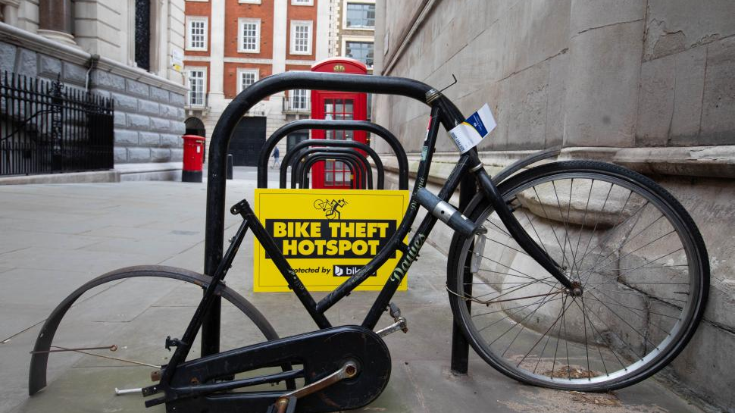
Quick Fact
Did you know that over 3,000 bikes are reported stolen in Toronto each year? [1]

Slide 3
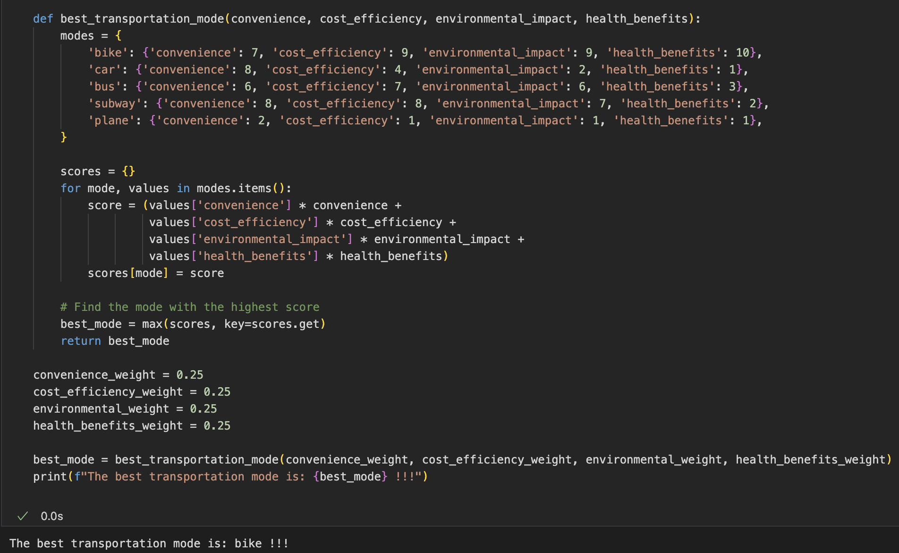
Why do we Need to Pay Attention to Bike Theft?

Slide 4
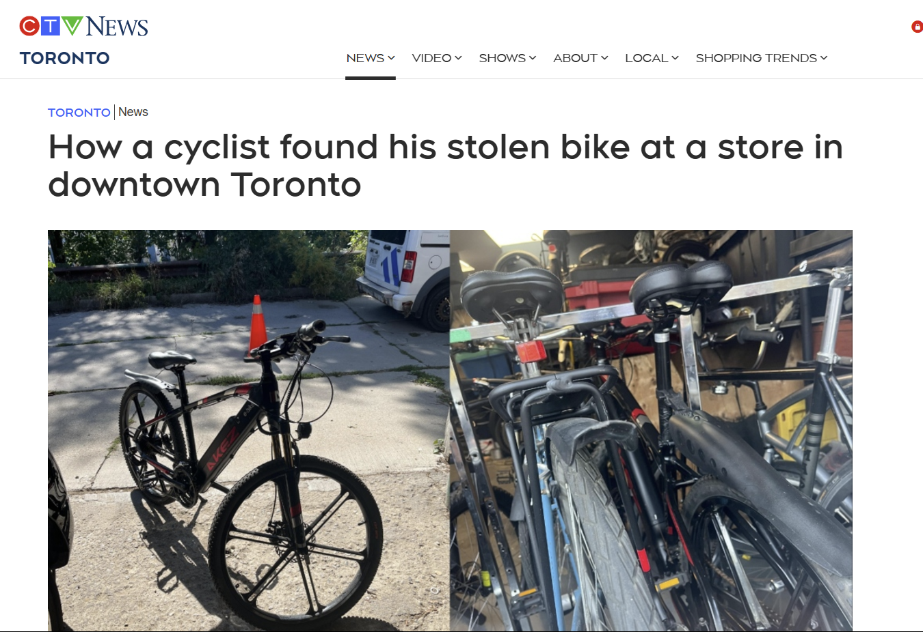
Why do Bike Thefts Occur?
[4]
There is a prominent black market [2] for stolen bikes in the heart of Toronto.
One infamous operation was the Queen West Bicycle Shop – which had stocked roughly 2,800 stolen bicycles [3].

Slide 5
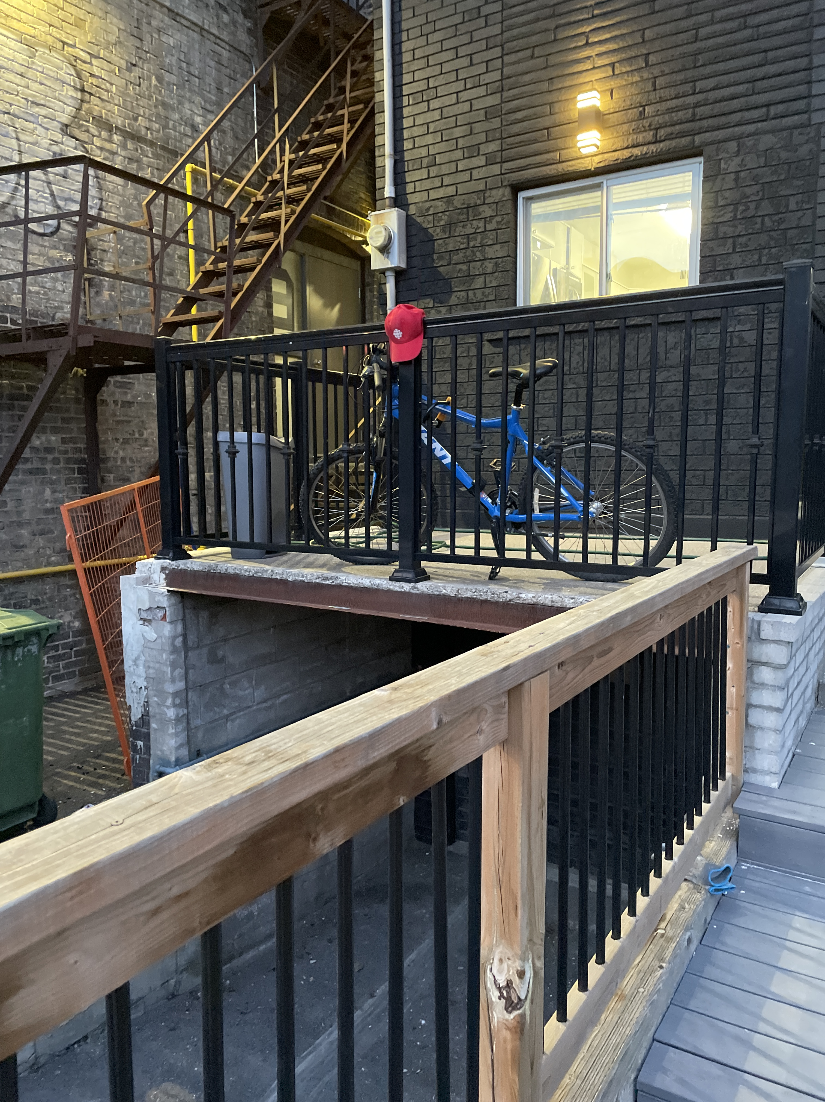
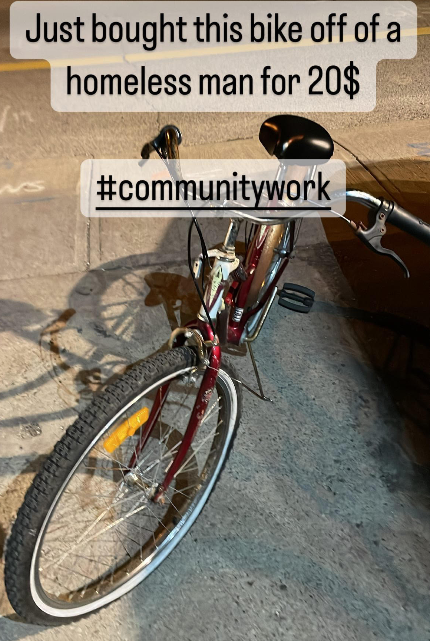
Personal Experience
Bikes can become a necessity for commuters aside from being a fun recreational activity [5].
Jason – has experienced two instances of bicycle theft & has inadvertently contributed to the local bicycle black market scene.

Slide 6
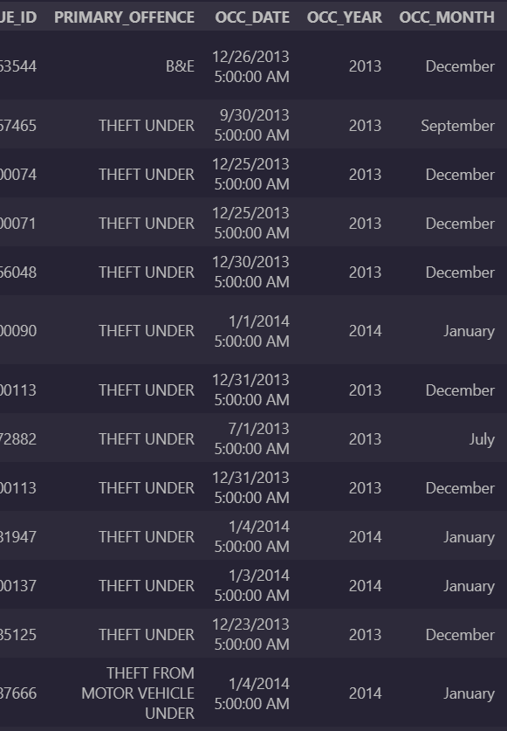
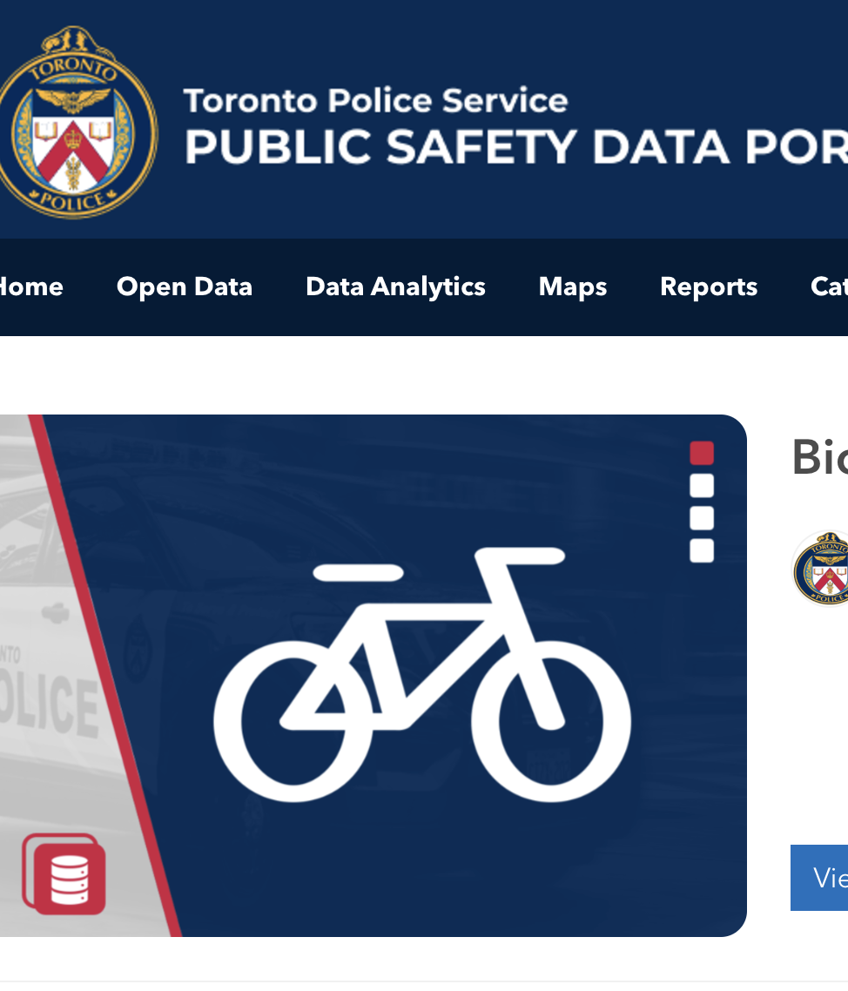
Data Overview
Toronto Police Services Bicycle Thefts Open Data [6]
Toronto Police Services Budget By Command Data [7]
Daily Shelter and Overnight Service Occupancy & Capacity – City of Toronto Open Data [8]
Neighbourhood Profiles – City of Toronto Open Data [9]

Slide 7











Data Processing Flowchart
Spatial Variation
Neighbourhoods
Other repos used as helpers/for convenience when needed
Temporal Trends
Create remote GitHub repo
Policing
Budgets
Seasonality
Bike Thefts in Toronto
Push/pull changes to/from repo as needed
Data
Collection
Data Cleaning
Exploratory Data Analysis (EDA)
Data visualization
Parse data from sources
Import packages to assist
Reported Thefts
Recovery Rate
Toronto Police Service Open Data Portal
Toronto Police Budget
Homeless shelters in the city
Neighbourhood profiles
Common characteristics, recovery of stolen bikes

Slide 8
Analysis Methodology
TPS Budget & Bike Theft Data Collection:
Accessed the TPS open data from TPS website
Performed EDA on different relationships such as Number of Theft VS Neighborhoods, Number of Theft VS TOD, Number of Theft VS Month etc..
The Budget Dataset was cleaned to exclude any revenue values – and analysis was performed only on 'Community Safety Command'
City of Toronto Shelter & Neighbourhood Data Collection:
Accessed the City of Toronto open data from City of Toronto website
Performed data cleaning and selection. Grouped key metrics (Shelter usage rate, neighbourhood income, neighbourhood popular commuting methods) to support EDA of Bike Theft relationships.
Point coordinates and Multipolygon coordinates used to create a Folium plot

Slide 9
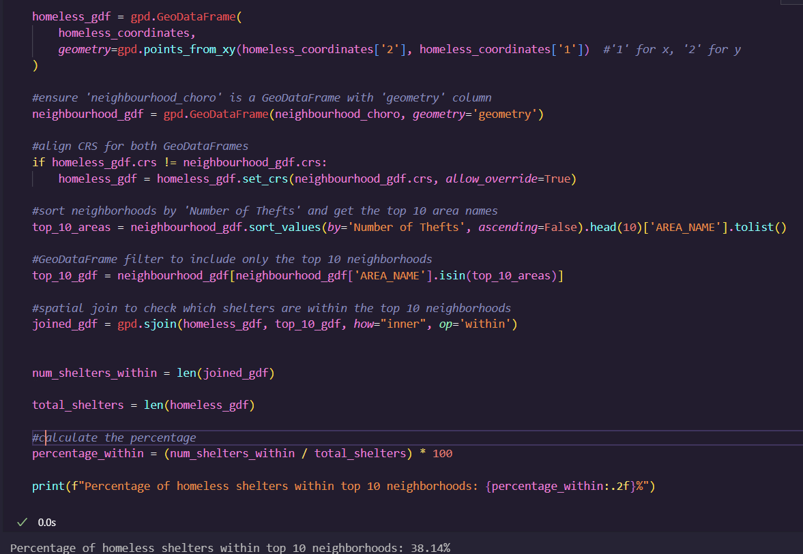
Key Findings
Seasonal Trend
Homeless Shelter
Recovery Rate
Neighbour-hood
Police Budget
Location Type

Slide 10
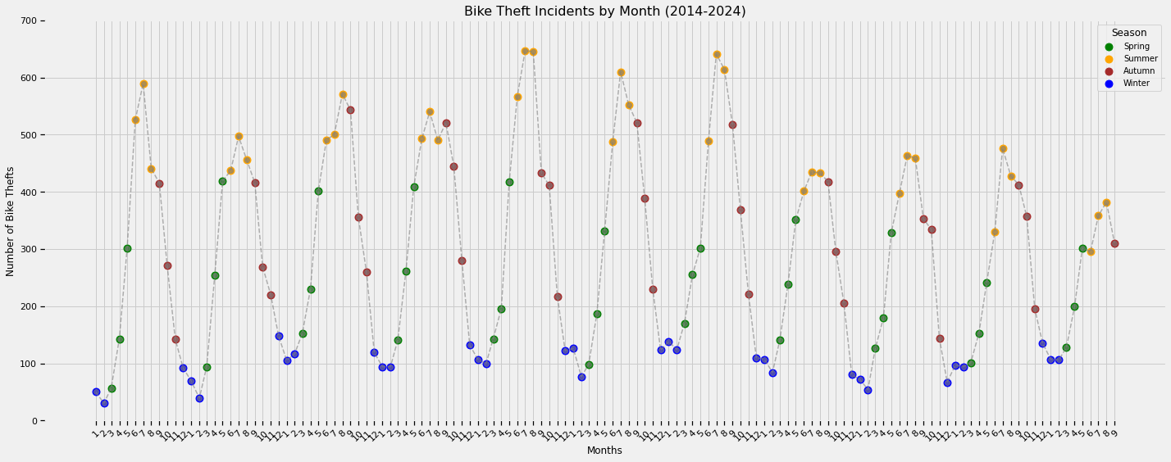
Visualizing Seasonal Trends in Bike Theft Incidents

Slide 11
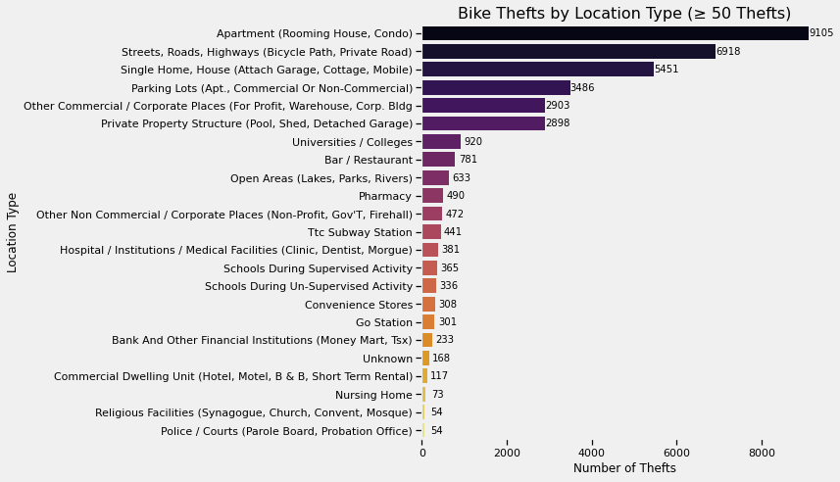
"Where Are Bikes Most Frequently Stolen?"

Slide 12
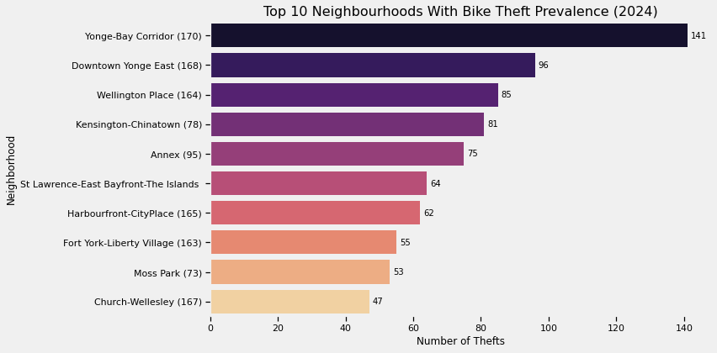
Bike Theft Hotspots in Toronto: Analyzing Neighborhood Vulnerabilities
Commonalities among these neighborhoods include high population density, robust cycling infrastructure, proximity to transit hubs, and significant commercial and tourist activities. These factors make these areas prime targets for bike theft.

Slide 13
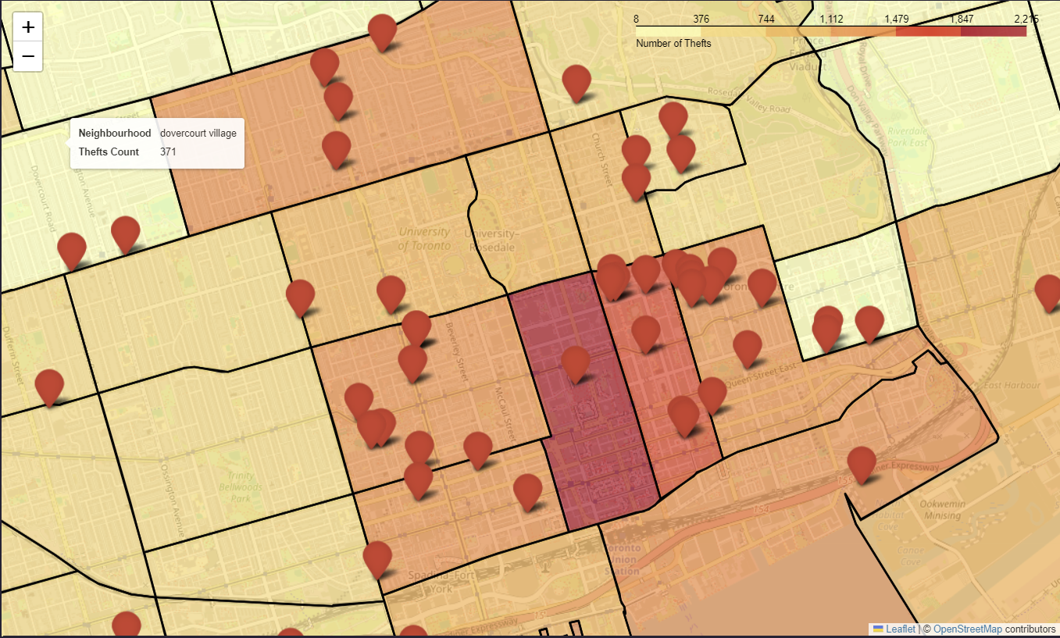
Impact of Homeless Shelters on Neighborhood Safety

Slide 14
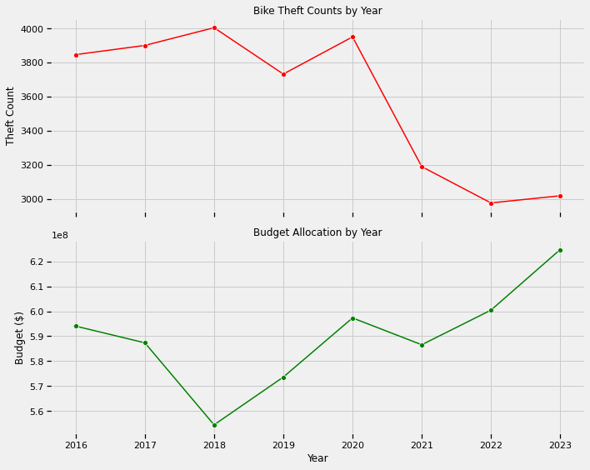
Analyzing the Correlation Between Budget Allocation and Bike Theft Counts
This dual-axis line chart shows the yearly bike theft counts alongside the budget allocations for bike safety and theft prevention from 2016 to 2023.
Notice the trends in how budget changes align with the increase or decrease in bike theft incidents.

Slide 15
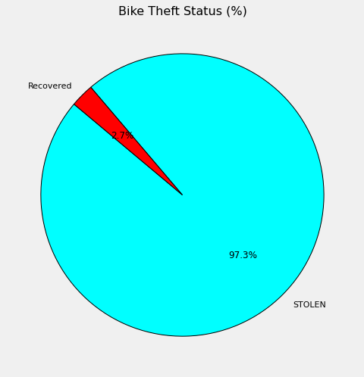
Recovery of Stolen Bikes: A Significant Challenge
The overwhelming majority, 97.3%, of stolen bikes remain unrecovered, underscoring the severity of the theft problem and the challenges in retrieval efforts.
Improvements are discussed.

Slide 16
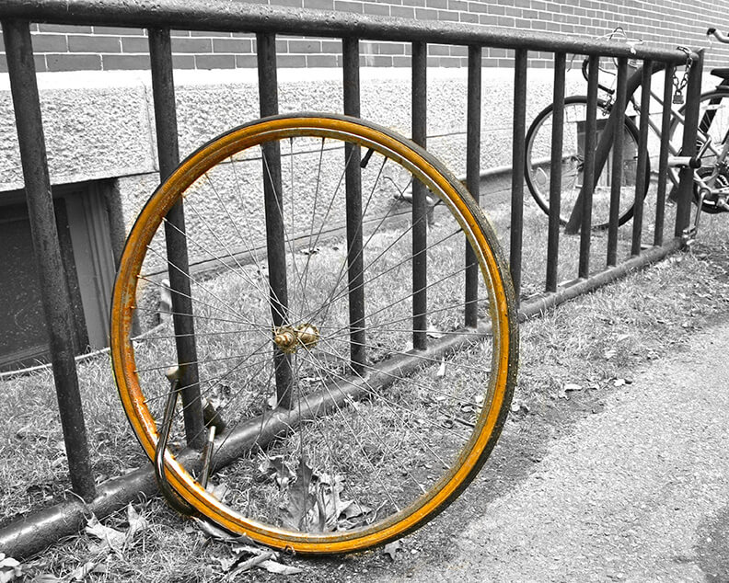
Recommendations
Enhanced Security
Registration and Tracking
Policy and Legislation

Slide 17
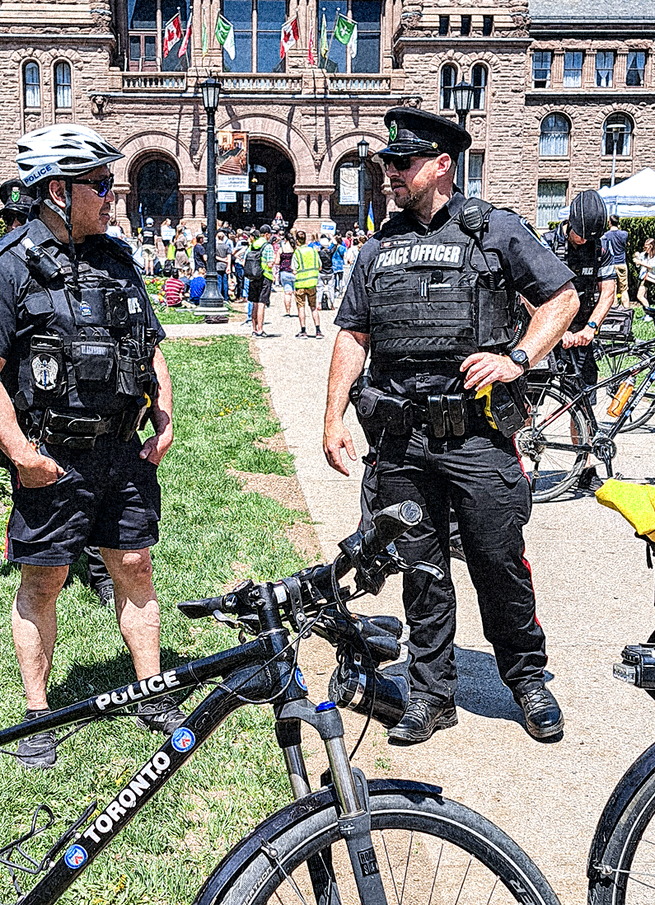
Enhanced Security in Hotspots
Deploy more resources: Increase police patrols and surveillance in bike theft hotspots during Spring and Summer, when thefts peak.
Community watch: Encourage the formation or reinforcement of neighborhood watch programs specifically tailored to monitor bike theft.
Increase Police funding: Additional patrols, specialized bike theft task forces, and advanced surveillance technology in high-risk areas.

Slide 18
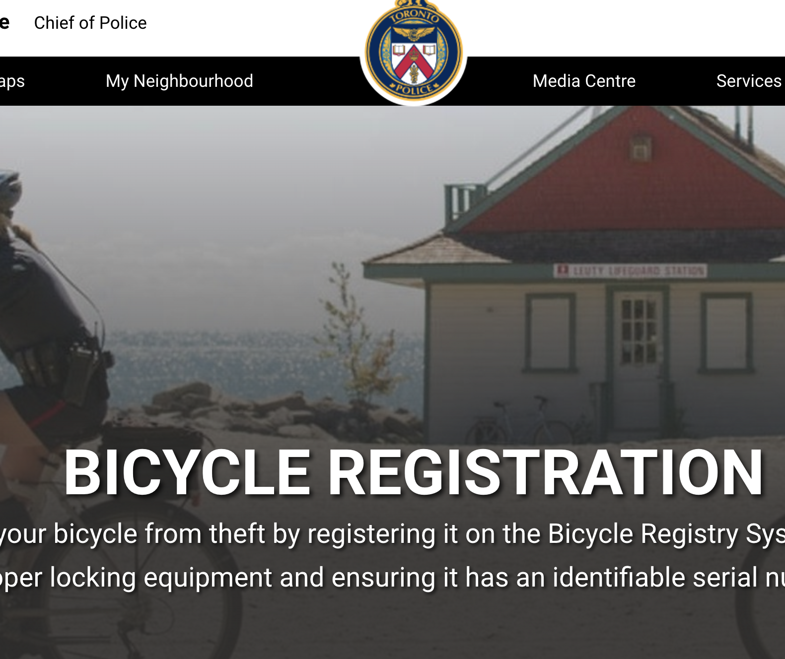
Registration and Tracking
Bike registration programs: Promote and possibly mandate the registration of bikes to create a deterrent for thieves and aid in the recovery process [10].
Use of GPS trackers: Encourage cyclists to install GPS trackers on their bikes, which can help locate them if stolen.

Slide 19

Policy and Legal Framework Enhancement
Tougher Penalties and Fast-Track Courts: Advocate for stricter penalties for bike theft and the establishment of fast-track courts to handle such cases, which could act as a deterrent.
Support and Compensation: Consider policies for compensating victims of bike theft, possibly through community funds or insurance programs.

Slide 20
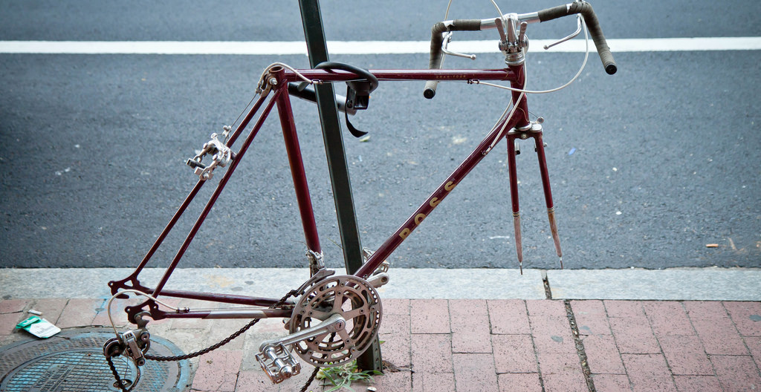
Conclusion
This Photo by Unknown Author is licensed under CC BY-NC

Slide 21
Thank You for Listening!

Slide 22
References
​[1] TPS Crime Statistics - Bicycle Thefts. Available: https://data.torontopolice.on.ca/pages/c78364ab031747359fa8afb78febdd3d.
​[2] 5 Factors That Can Contribute To Bike Theft. Available: https://www.handi-hut.com/5-factors-that-can-contribute-to-bike-theft/#:~:text=Inadequate%20Locking%20Mechanisms,and%20easy%20theft%20without%20complications.
​[3] Bloor West Villager, "Queen West bike shop owner granted bail,“ Toronto.Com, 2008. Available: https://www.toronto.com/life/queen-west-bike-shop-owner-granted-bail/article_7704752b-b25c-5eab-ac5b-79861fb1bdb9.html.
​[4] A. Arsenych, "How a cyclist found his stolen bike at a store in downtown Toronto," CTV News Toronto, 2023. Available: https://toronto.ctvnews.ca/how-a-cyclist-found-his-stolen-bike-at-a-store-in-downtown-toronto-1.6592183.
​[5] N. Brockbank, "Here's where your bike is most likely to get stolen in Toronto," CBC, 2017. Available: https://www.cbc.ca/news/canada/toronto/worst-toronto-neighbourhoods-bike-theft-1.4421633.
​[6] (Sep 18). Bicycle Thefts Open Data. Available: https://data.torontopolice.on.ca/datasets/TorontoPS::bicycle-thefts-open-data/about.
​[7] (Sep 18). Public Safety Data Portal - Budget by Command. Available: https://data.torontopolice.on.ca/datasets/TorontoPS::budget-by-command/explore.
​[8] (Nov 28). Daily Shelter & Overnight Service Usage. Available: https://www.toronto.ca/city-government/data-research-maps/research-reports/housing-and-homelessness-research-and-reports/shelter-census/.
​[9] Neighbourhood Profiles. Available: https://www.toronto.ca/city-government/data-research-maps/neighbourhoods-communities/neighbourhood-profiles/.
​[10] Bicycle Registration. Available: https://www.tps.ca/services/bicycle-registration/.

